Slide 1

Machine Learning with PyCaret
Moez Ali
Creator of PyCaret

Slide 2
Agenda
Introduction
Machine Learning Life Cycle
PyCaret
Demo
Q&A

Slide 3





About me
Background: Finance + Economics + Computer Science + Data Science
Industry: Healthcare + Education + Consulting + Fintech
Work: Asia + Middle East + East Africa + North America
Open-Source: PyCaret
https://www.linkedin.com/in/profile-moez/
https://medium.com/@moez_62905/
https://twitter.com/moezpycaretorg1
moez@pycaret.org

Slide 4
Important Links
Official: https://www.pycaret.org
GitHub: https://www.github.com/pycaret/pycaret
LinkedIn: https://www.linkedin.com/company/pycaret
YouTube: https://www.youtube.com/channel/UCxA1YTYJ9BEeo50lxyI_B3g
Medium: https://medium.com/@moez_62905/
Slack: https://join.slack.com/t/pycaret/shared_invite/zt-nm02k73a-PSDo5lwmQ6evlFCPRxsKKA
Demo: https://www.github.com/pycaret/pycaret-demo-dataai2021

Slide 5
Machine Learning Life Cycle
Model Training & Selection
Deployment & Monitoring
Business Problem
Data Sourcing & ETL
Exploratory Data Analysis (EDA)
Data Prep.
Model Training & Selection
Data Prep.

Slide 6
Data Prep, Model Training and Selection
Data
Train Test Split
Train
Missing Values Imputation
Feature Scaling
Encodings
Feature Engineering
Test
Finalize Pipeline
Deploy
Monitor
Cross Validation Environment
Model Training
Model Tuning
Model Selection
Model Ensemble
Optional

Slide 7
Challenges of Machine Learning Lifecycle
Machine Learning is an iterative process. It is very time consuming.
Right tooling in the hands of right people is very important.
Creating a seamless pipeline is hard. Managing it in production is harder.
Focus on end-goal and solving business problems can take a backseat within small teams with increasing technical debt.
Scalability is not just desirable, but it is very much needed.

Slide 8



What is PyCaret?
PyCaret is an open source, low-code machine learning library and end-to-end model management used to automate machine learning workflows. It is commonly used for rapid prototyping and deployment of ML pipelines.
EASY TO USE
PRODUCTIVITY TOOL
BUSINESS READY

Slide 9






PyCaret Features
Data
Preparation
Model
Training
Hyperparameter
Tuning
Analysis &
Interpretability
Model
Selection
Experiment
Logging

Slide 10
Machine Learning use-case supported:
Classification
Regression
Time Series
SUPERVISED
Clustering
Anomaly Detection
Association Rule Mining
Natural Language Processing
UNSUPERVISED

Slide 11
Impact of PyCaret
Cumulative lines of code
Machine Learning Workflow Level

Slide 12
Statistics
500,000+
3,000+
46
1,700+
Downloads
Git Stars
Contributors
Commits

Slide 13
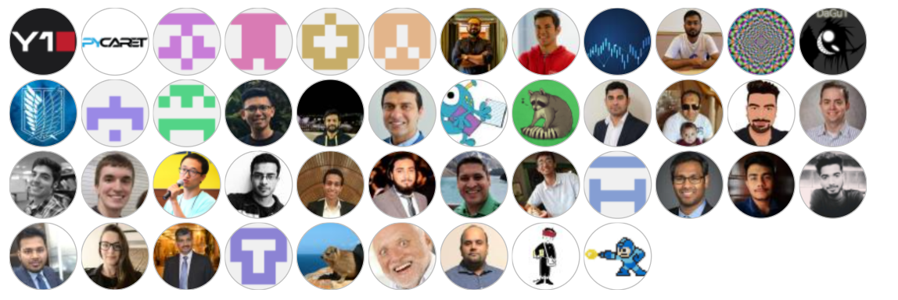
Contributors

Slide 14


PyCaret on GPU and on distributed cluster
Training on GPU
Scalable Hyperparameter Tuning

Slide 15











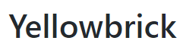
PyCaret Integrations

Slide 16
Demo
Demo 1 – Regression Problem on Insurance data
Demo 2 – Time Series Forecasting using Regression
Demo 3 – Multiple Time Series Forecasting
Demo 4 – Model serving through MLflow API
All Notebooks are available here:
https://www.github.com/pycaret/pycaret-demo-dataai2021

Slide 17


Feedback
Your feedback is important to us.
Don’t forget to rate and review the sessions.

Slide 18
APPENDIX

Slide 19
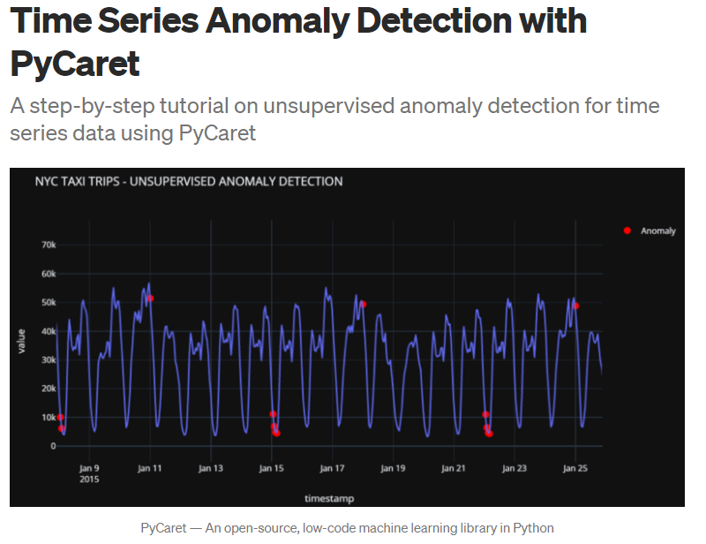
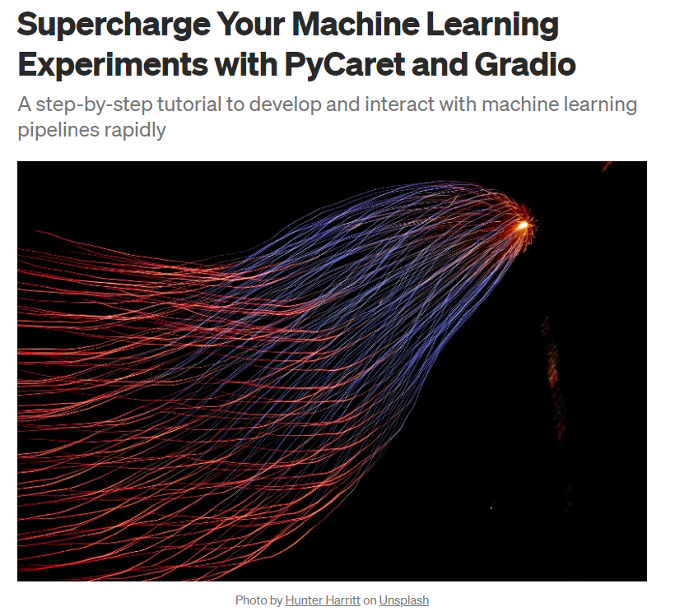
Resources

Slide 20
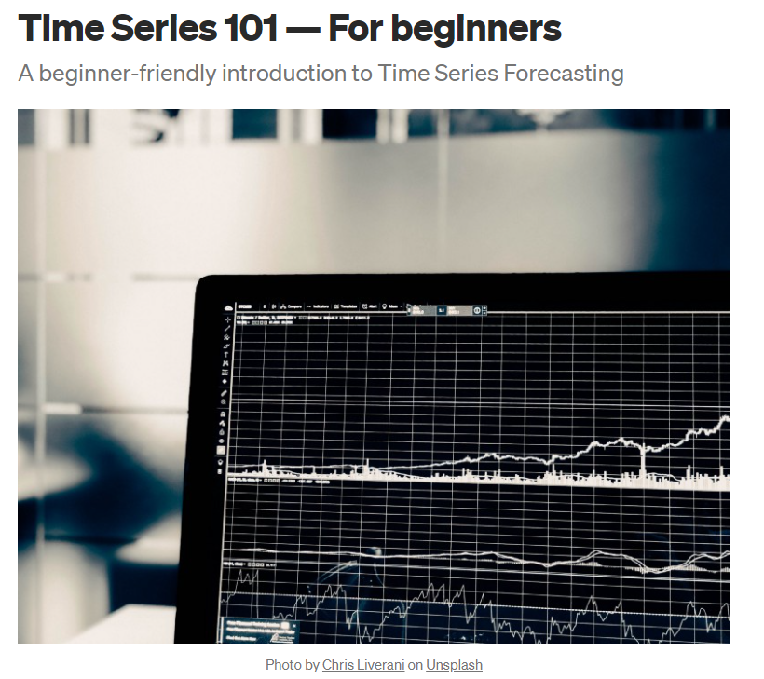
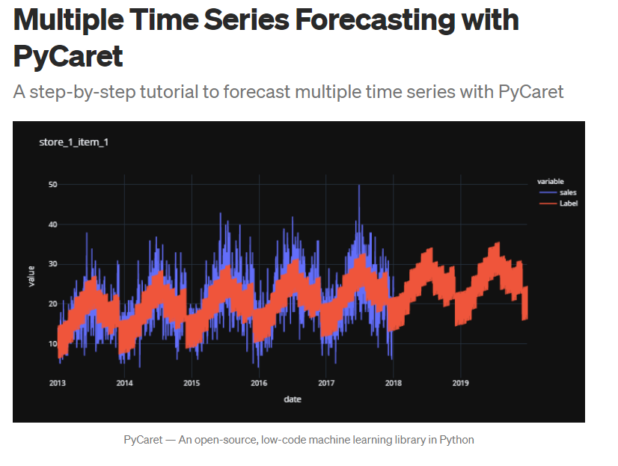
Resources (cont.)

Slide 21
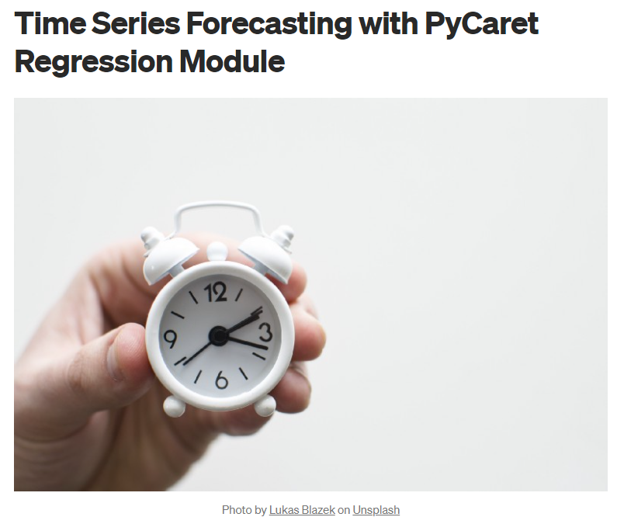
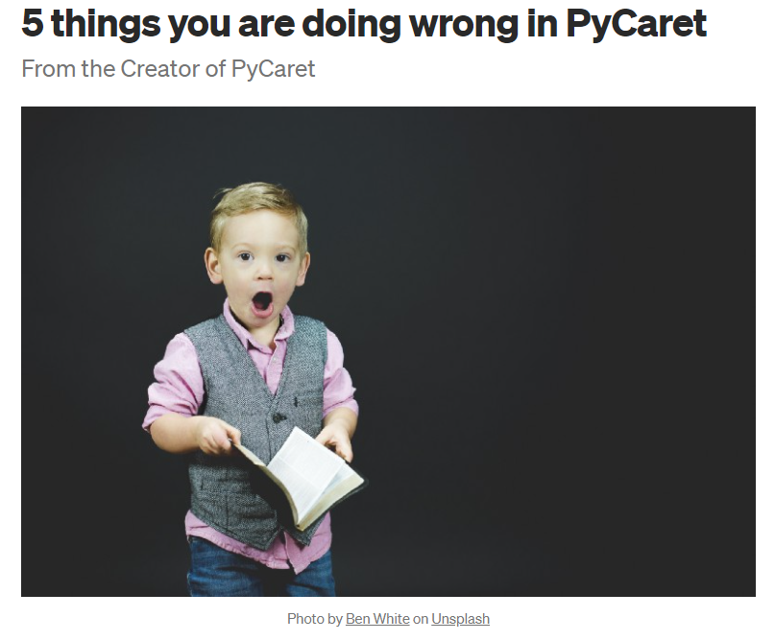
Resources (cont.)

Slide 22
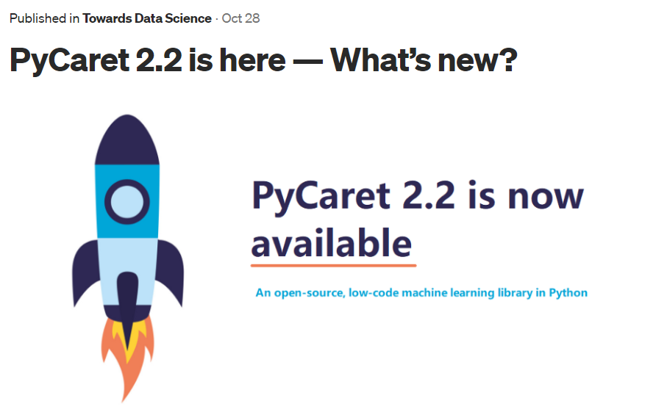
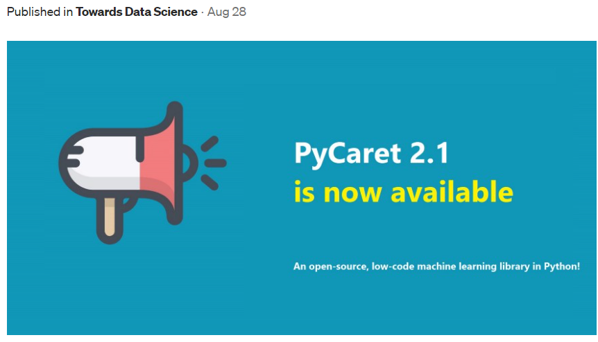
Resources (cont.)

Slide 23
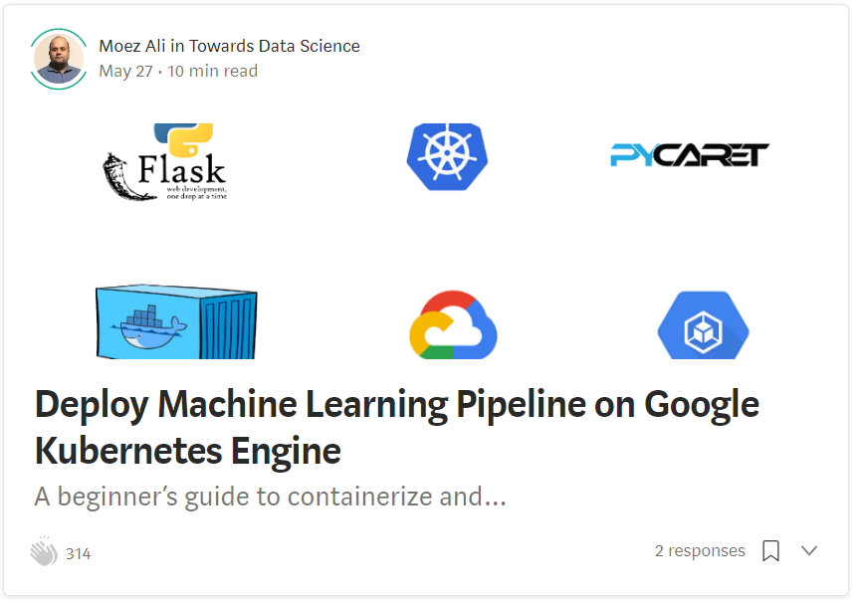
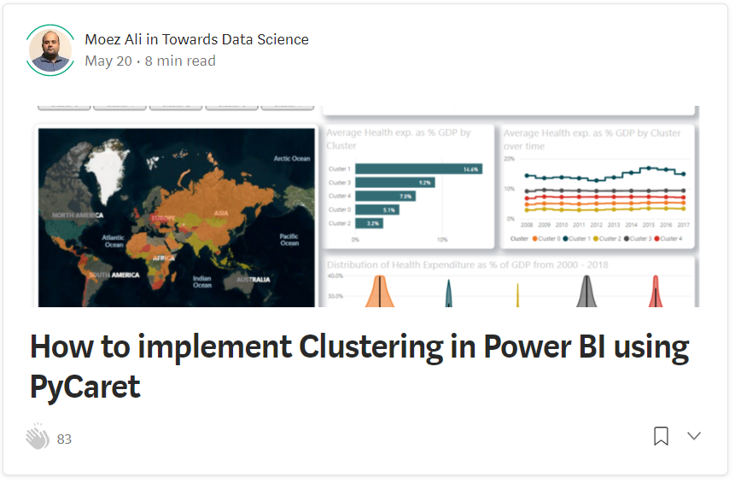
Resources (cont.)

Slide 24
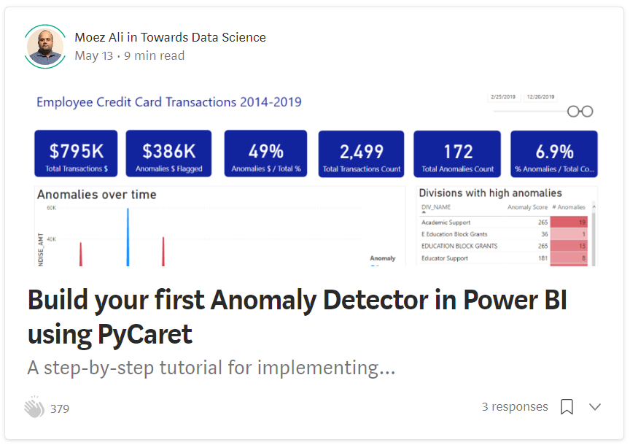
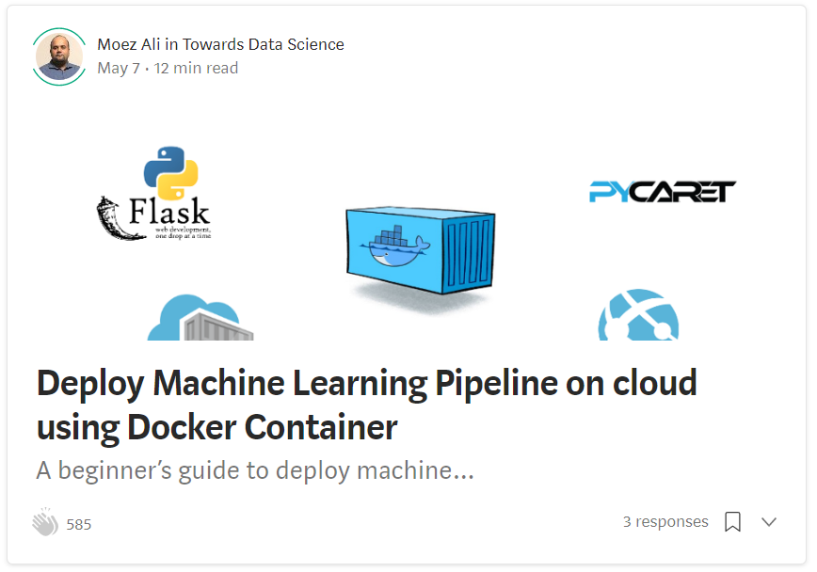
Resources (cont.)

Slide 25
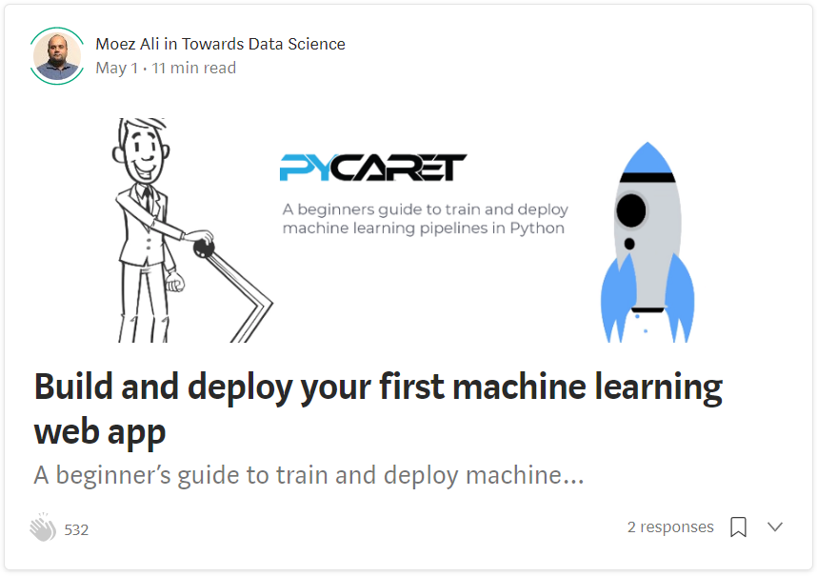
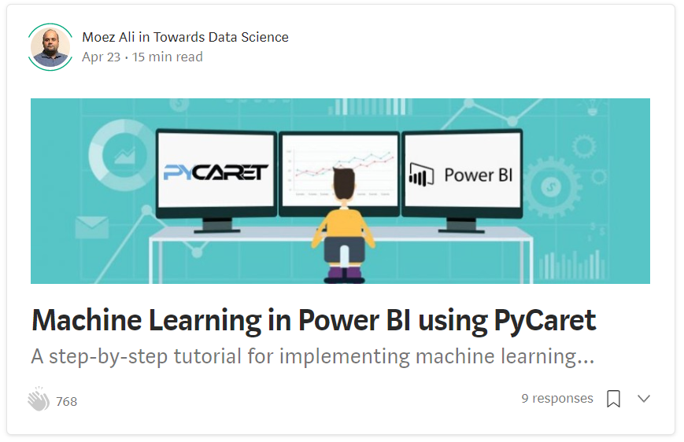
Resources (cont.)

